Slide 1

Incentive
History
Optimization by ML
Profit
MLResult
Benefits
Problem
About
PRESENTED BY SIVARANJINI

Slide 2
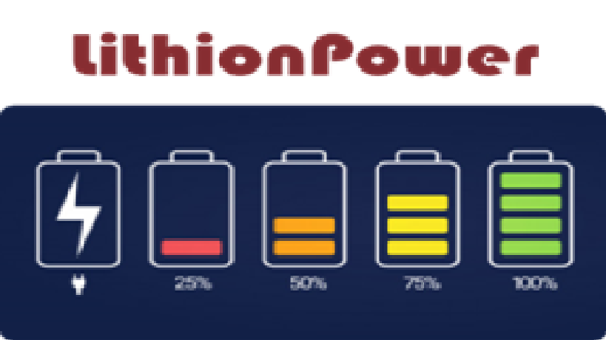
Profit
Benefits
History
MLResult
Problem
About
About
The Company
Lithion power is the largest provider of electric vehicle(e-vehicle) batteries. Drivers rent battery typically for a day and then replace it with a charged battery from the company.

Slide 3



Target
Variable
Variable
1
2
3
Profit
Driver Incentive
Driver Average Speed
Driver
Over
Speed
History
MLResult
Benefits
Problem
About
To be Determined
(Data Available)
(Data Available)

Slide 4
PROBLEM STATEMENT
Develop a variable pricing model based on the driver’s driving history for Lithion power. As the life of a battery depends on factors such as over speeding, distance driven per day
Profit
History
MLResult
Benefits
Problem
About
Step 1
Step 2
Step 3
Understand Data
Create a cluster model for drivers
Develop a Incentive Model
4000 Drivers
&
Driving History
Identify driver Groups & Charge drivers with poor history more
Accurately Group using K-means Clustering & check the incentive model mathematically

Slide 5
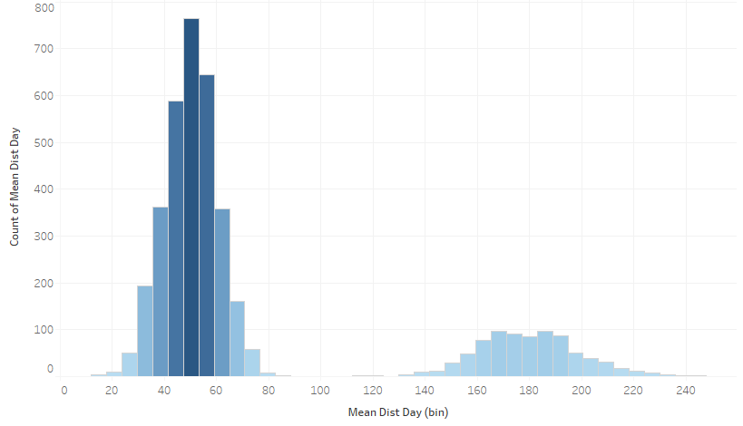
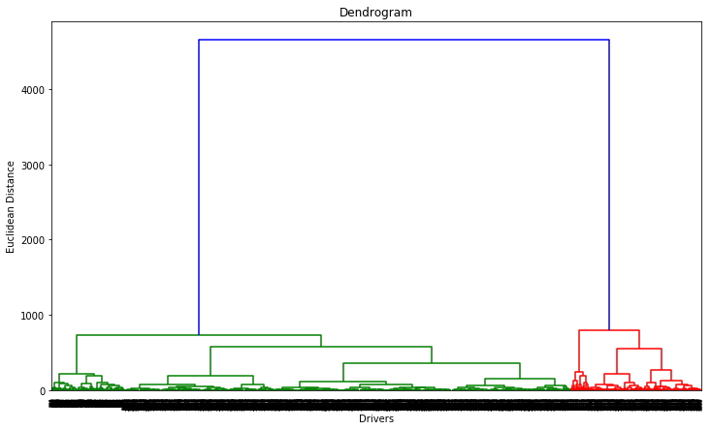
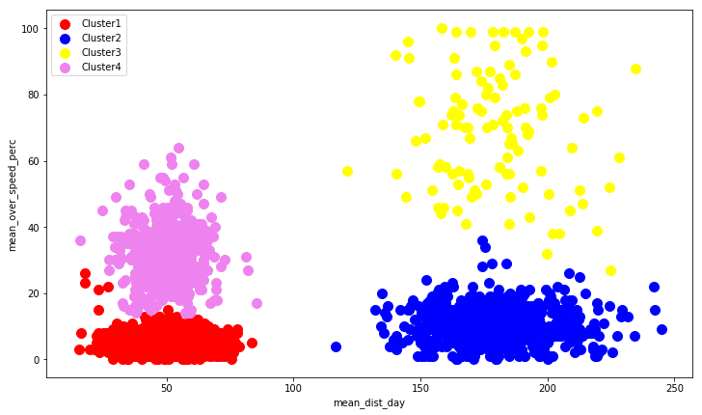
01
02
03
Profit
History
MLResult
Benefits
Problem
About
Data Analysis
K Means Clustering
Incentive Model
Distribution of Distance & Speed
Grouping Drivers
Based on History
Define the Rental Price according to Groups
Histogram, Driver Matrix
(Data Visualization)
Elbow Diagram + Hierarchical Clustering
(Machine Learning : Python)
Calculate the incentivized pricing for different driver groups

Slide 6






Profit
MLResult
History
Benefits
Problem
About
Static Pricing Model
Dynamic Pricing Model
Profit - 36,00,000 INR
Profit - 36,90,000 INR (2 Groups)
- 37,32,900 INR (4 Groups)
Advantages
Advantages
Uniform Pricing for all drivers
Categorized Drivers & Higher Profit
Disadvantages
Disadvantages
Poor Profit to the company
It is dynamic & the group may change as data or driving pattern changes

Slide 7



Profit
History
MLResult
Benefits
Problem
About
4000
1,32,900 INR
4% Inc
Drivers Segmentation
Revenue Maximization Strategy
Overall Impact
on
Profit (Incentive)

Slide 8
